Slide 1
Park Place Elementary
No Place Like Park Place!
Pre-k
4 Color Pack o Play-Doh (4 Oz )
1 Large box of Kleenex
1 Kinder Rest Mat 5/8” X19x45 Quad
1 Hand Sanitizer With Pump (8 Oz)
2 Boxes of unscented Baby Wipes Soft Pack (80 Count)
1 Lysol Disinfectant Wipes (35 Count)
1 Roll of Paper Towels
Kinder
1 Box of Facial Tissue (120 Count)
1 Hand Sanitizer With Pump (8 Oz)
1 Unscented Baby Wipes Soft Pack (80 Count)
1 Mead Primary Composition Journal (for Sci) 100 sheets ½ “ruling 9 ¾ in. x 7 ½ in
2 Composition Book Second Grade ½ “Rule, RED baseline with dotted midline
4 Plastic Pocket Folders
1 White Binder with Clear Sleeves (1 inch)
1 Roll of Paper Towels
1st Grade
1 Box of Facial Tissue (Kleenex)
1 Bottle of Hand Soap
1 Bottle of Hand Sanitizer
1 Box of Baby Wipes
1 Roll of Paper Towels
6 First Grade Composition Books
(picture of an elephant or a lion on the cover)
1 White Binder with Clear Sleeves (1 inch)
6 Folders with Pocket and Brads
(2 Red, 2 Blue, 2 Yellow)
1 Large School Pouch
1 Package of Lunch Bags (brown or white)
2nd Grade
1 Box of Facial Tissue (120 Count)
1 Hand Sanitizer With Pump (8 Oz)
1 Unscented Baby Wipes Soft Pack (80 Count)
2 Clorox Disinfectant Wipes (35 Count)
3 Composition Multi Method Grade 1-3
1 Pkg. of Wide-Ruled Paper
1 Pencil Sharpener with Lid
1 Spiral Notebook 70 Pages
1 Zipper Pouch or Supply Box
1 Set of Ear Buds or Head -Phones
1 Roll of Paper Towel

Slide 2
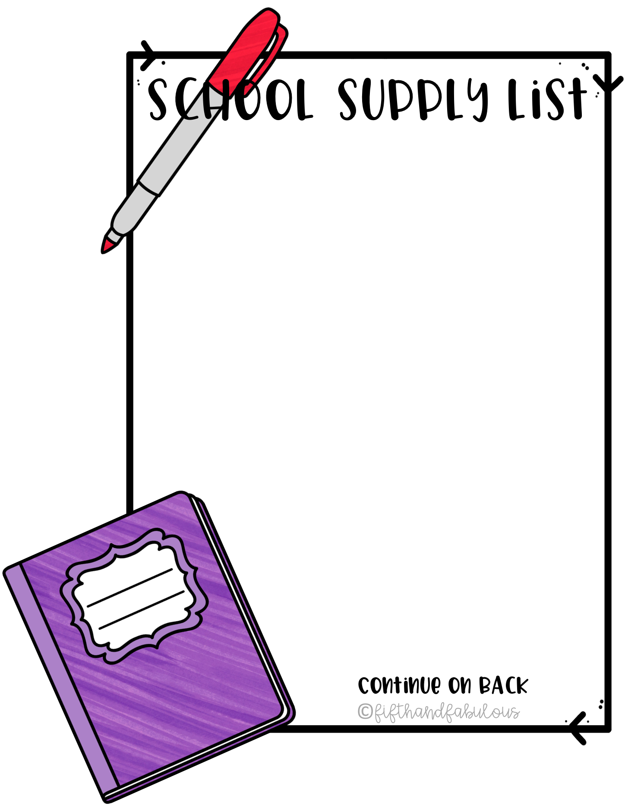
3rd Grade
1 Red pen
1 Pack of wide Ruled Notebook Papers
1 Grid Composition Notebook
1 Composition Notebook
2 Three-Rings Binder
2 Pocket Folders
1 Hand Soap
1 Unscented Baby Wipes Soft Pack (boys)
4th Grade
1 Ruler
1 Protractor
1 Package of Red Checking Pens
1 Box of Facial Tissue (120 Count)
1 Bottle Liquid Hand Soap
1 Hand Sanitizer With Pump (8 Oz)
2 Composition Notebooks
4 Pocket Folders
1 Pack of Small Index Cards
1 Pack of Soft Unscented Baby Wipes (80 Count)
1 Lysol Disinfectant Wipes (girls)
1 Roll of Paper Towels
1 Box of Facial Tissues
1 Pair of Ear Buds or Headphones
5th Grade
7 Composition Notebooks
1 Tape Dispenser
5 Pack of Scotch Tape
4 Folders with Prongs
1 Memory Stick
2 Pairs of Ear Buds
1 Roll of Paper Towels
1 Box of Facial Tissue (120 Count)
1 Hand Sanitizer With Pump (8 Oz)
1 Lysol Disinfectant Wipes (35 Count)
(1) 2” Binder (Only for 5th Grade Regular)
1 Packages of wide-ruled filler paper
Lysol Disinfectant Wipes (35 Count)
2 Pair of Earbuds
1 Roll of Paper Towels
1 School Pencil Box/Bag
1 1 ½ inch Binder
1 Package of Plastic Dividers
1 Package of Graph Paper
Dear Parents,
We are very excited to inform you, to minimize the financial burden during a global pandemic, we have reduced the number of materials and supplies required for purchase for this coming school year. As a campus, we plan to reach out to community/business partners for many of the commonly used supplies and materials for our students, such as crayons, pens, scissors, and paper etc. In addition, we also plan to purchase some of these items. Some classroom teachers may request additional specific items apart from the school's primary list. Please contact your child's classroom teacher during “Meet the Teacher” if you have questions about these items.
Thank You.

